Slide 1
cobalt: CAD toolbox and generator
Makes heavy use of existing open-source Python packages:
pythonOCC (T. Paviot)
Python bindings for OpenCascade Community Edition (OCE)
Makes light use of:
Trimesh
STL mesh generation and export
Aocxchange
STEP file export (assemblies)
Makes CATIA modelling look embarrassingly expensive

Slide 2
Motivations: a word on CAD..
Present “state of affairs” of CAD in (fusion) engineering:
Non-parametric CAD (very few exceptions…)
Highly specialised software (CATIA)
With extremely expensive licences
Which is solely used by “designers” or “CAD technicians” (partly because of licence cost)
Which, by the way, has got loads of neat ways of doing parametric CAD
CAD outputs not immediately compatible in neutronics and/or FE codes
CAD is relatively slow to make, and costs a lot
My take on this:
A tragic misuse of some very clever software
A great way to permanently separate design and analysis
Fantastic for some who are happy to perpetually do the same thing every year (disciples of Sisyphus)
Possibly the single greatest affront to productivity in engineering in the 21st century

Slide 3
cobalt: capabilities
Set of fundamental CAD operations:
Extrude
Revolve
Sweep
Loft
Boolean cut
Boolean fuse
Set of fundamental CAD modifications:
Rotate
Translate
Mirror
Scale
Two useful primitives:
Polygons
Splines
CAD viewers:
(pyQt5-based, OCC source)
HTML (OCC source derivative)
CAD build algorithms for all major tokamak components (typical designs)
BB, VV, …
Export CAD in:
STEP
STL

Slide 4
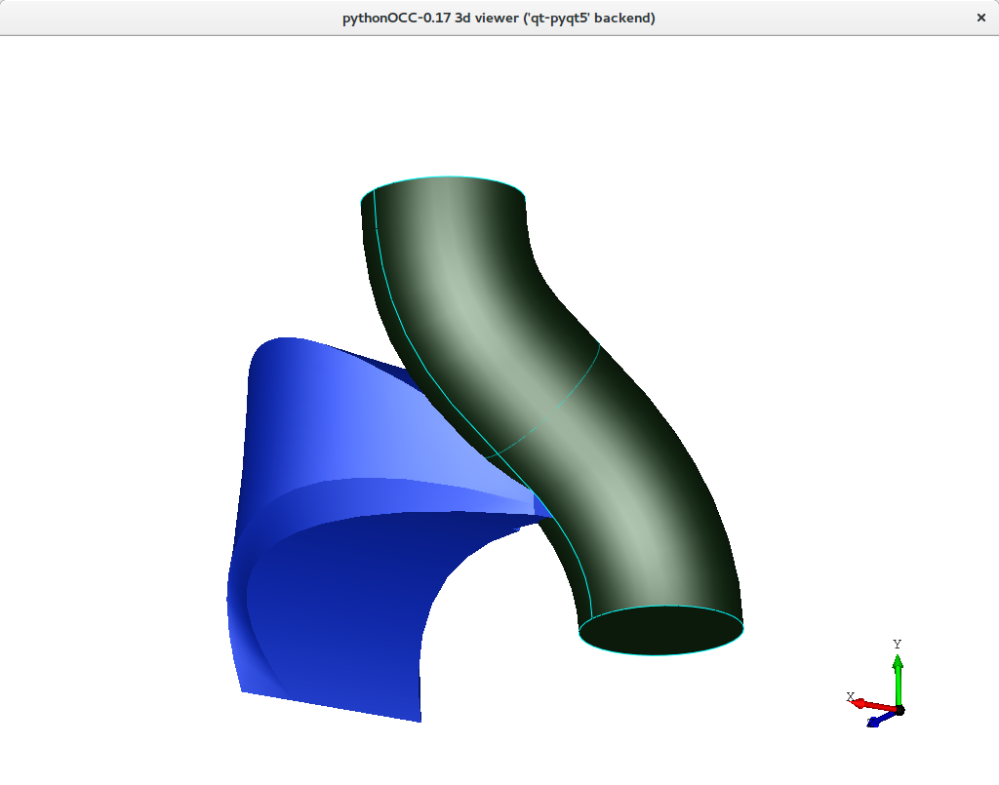
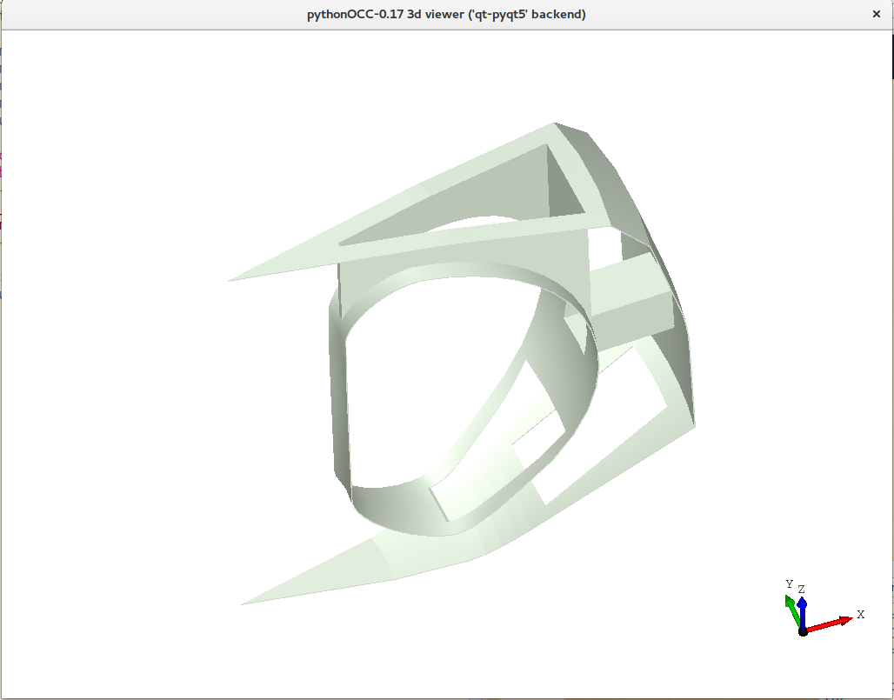
From simple to strange shapes

Slide 5
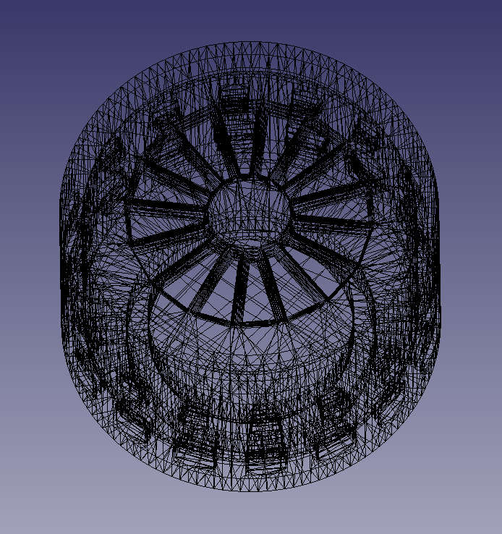
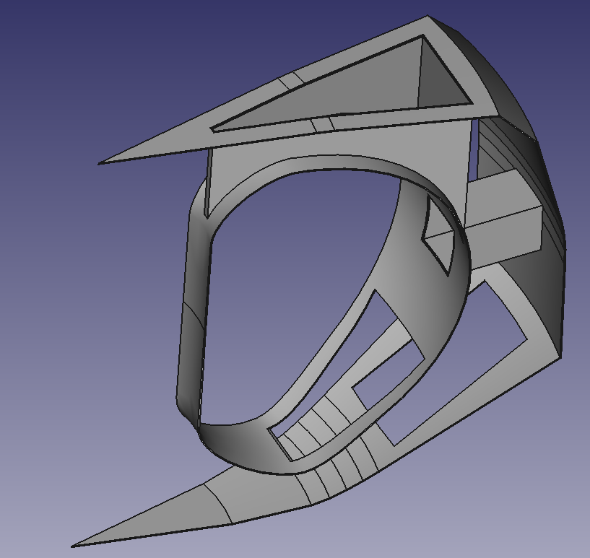
Export to STEP and STL

Slide 6
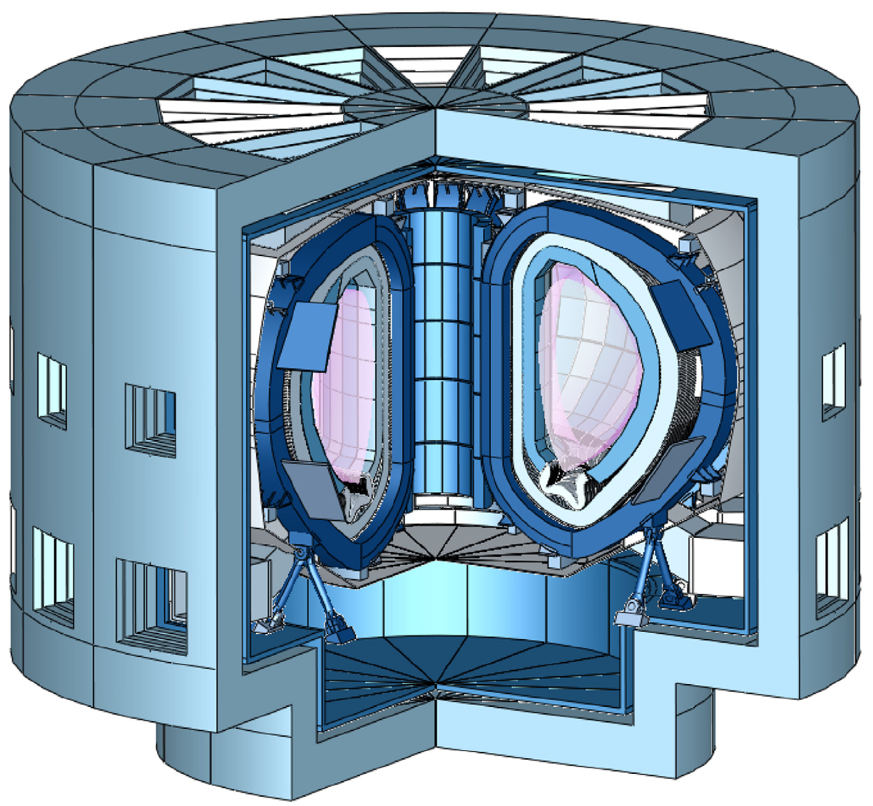
cobalt: EU-DEMO-like CAD build
30 seconds (1 CPU)
~10⁴-10⁵ times faster than present methods
Parallel ops:
10-15 seconds?

